Slide 1
Road Accident Analysis
Candidate : Ayesha Khan
Date : 8 August 2021

Slide 2
Preface
PART ONE
I : Introduction
II : Contributing Factors vs Cause
III : Aim
PART TWO
Summary and Story Telling

Slide 3
Introduction
Victoria is Australia’s second largest populated state.
There is a huge impact on the society due to road accidents in Victoria where there is a great costs of fatalities and injuries.
Causes are attributed to driver, pedestrians, vehicle condition and road environment.
Analysis of number of people killed, severely injured and hospitalized.

Slide 4
Contributing Factors vs Cause
Contributing factors are the conditions found in the operating environment:
Driver Behaviour
Driver Condition
Road Conditions
Although these factors or conditions do contribute in accidents – they are not the cause of the accident. The cause of the accident is the over-riding decisions that the driver makes given the conditions found in the operating environment.
The cause of the accident comes down to human error

Slide 5
Aim
Analyses of the road accidents dataset in Victoria. The dataset has two years (2011-2012) of records with 25,485 rows and 34 columns. In brief the dataset comprises of geometric coordinates(Latitude and Longitude) of the accident zones and detailed description about the accident description, Road Geometry, Light condition, accident type, reason of accident, Road name, speed, date and time, injury and severity description.
Initiatives for road safety and improvement of accident rate.

Slide 6
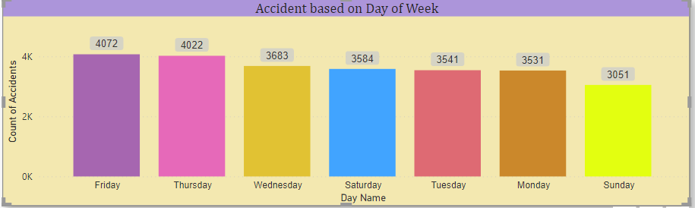
Day of Week
Majority of accidents in Victoria were reported on Friday and less accidents were reported on Sunday.
Initiatives: Expanding rush hour lanes, Encouraging incident-related roadway clearing , providing real time traffic updates.

Slide 7
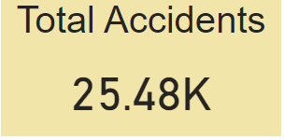
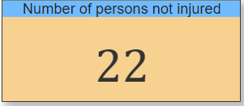
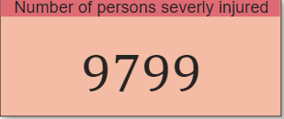
Total Accidents
According to Data source of Victoria a total of 25,000 accident’s took place between 2011 & 2012.
As per the data there were 9799 severely injured persons involved in an accident and 22 persons were not injured in an accident.

Slide 8
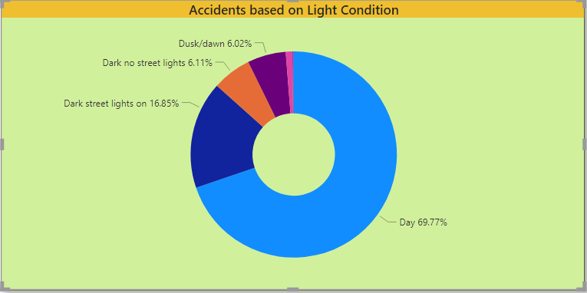
Description of Light Condition
In Victoria most number of accidents took place in Light Conditions. Day light conditions accounted 69.77% of accidents.
Initiatives: Using Telematics (Cloud technology) for accurate and better traffic and weather data reading. Installing HPS (High pressure sodium Vapor) lamps on roads for dark and dusk conditions.

Slide 9
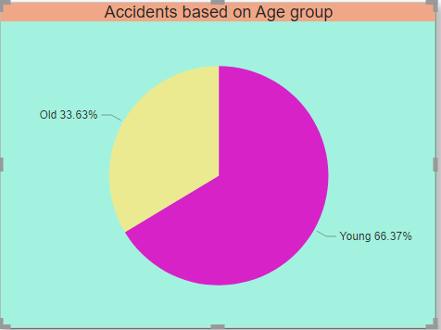
Age Group
Highest number of drivers involved in an accident were young drivers accounting 66.37% , while on the other hand old drivers involved in an accident were the least at 33.63%.
Initiatives: Hands on training for new and young drivers by using driving simulator technologies for better understanding of roads. Social media campaigns for road safety and safe driving measures.

Slide 10
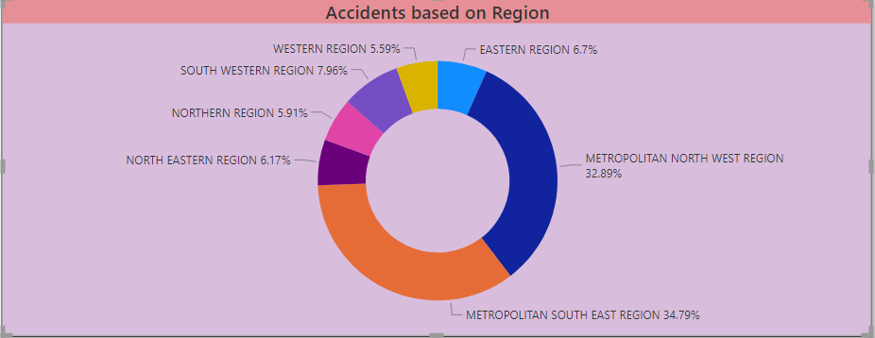
Region
Most number of accidents took place in metropolitan south east region. On the other hand, Western region recorded the least number of accidents.
Initiatives: Development of intelligent systems such as Motorist Assistance Systems for road traffic management is a way of solving road traffic safety and other such issues.

Slide 11
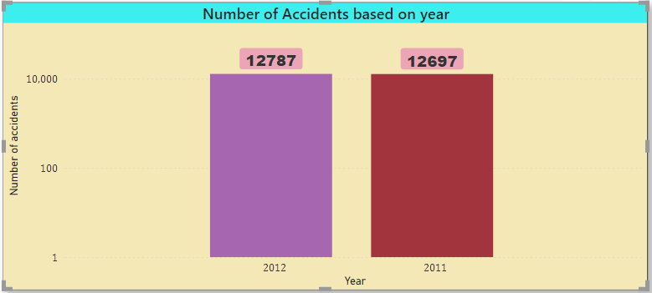
Year
This data set contains road accident data for the year (2011-2012).
Analyzing the data more accidents were recorded in the year 2012 than compared with 2011, there was an increase of 90 accidents in the year 2012.

Slide 12
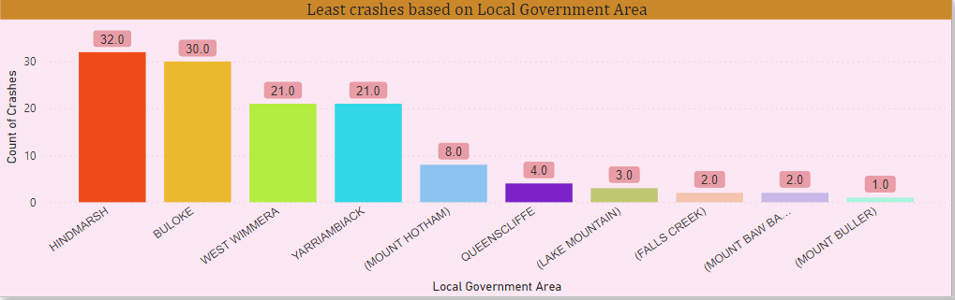
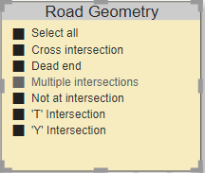
Local Government Area
As per Road Geometry, Mount Buller has recorded the least number of accidents and Hindmarsh (LGA) has recorded the highest number of accidents.
Initiatives: Installing impact-absorbing guard rails and other damage-reducing facilities on roads.

Slide 13
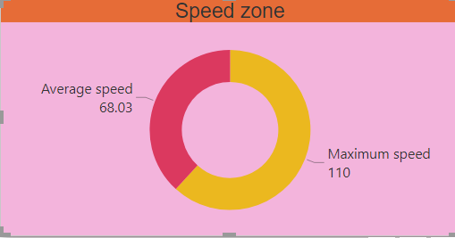
Speed
Speeding has been the major cause of accidents in Victoria. Average speed of driving was recorded at 68.03 while most accidents took place due to over speeding.
Initiatives: -- Better designed roads, safety education campaigns and visibly placed speed cameras can help in achieving better driver behaviour on roads.

Slide 14
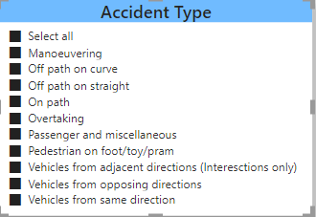
Description Code Accident type
Vehicles travelling in either same direction or in opposite direction was the major reason contributing in accidents.

Slide 15
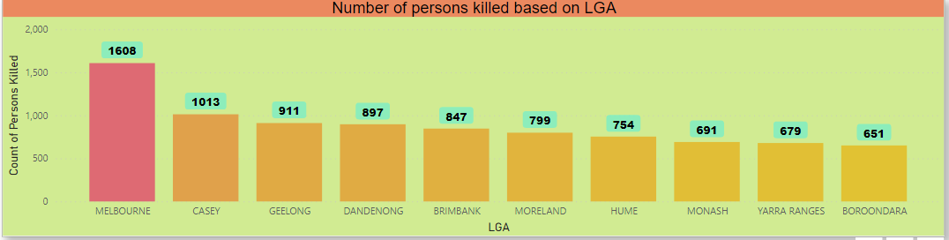
Number of persons killed
As per data sources Melbourne council recorded highest number of people killed, where as Boroondara recorded least number of fatalities.
Initiatives: Use of AI technology for predicting dangerous possibilities on roads and installing sensors to alert distracted drivers should be considered.

Slide 16
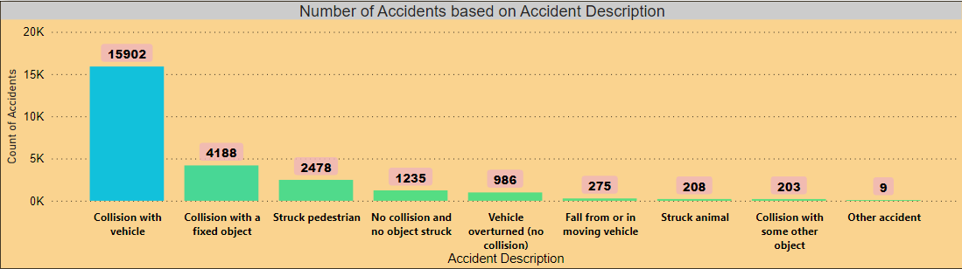
Accident Description
Collision with vehicle was the major reason among various other reasons for accidents. There were 15902 collisions involving vehicles.
Initiatives: Reducing the number of old and unsafe vehicles from the road. Preparing the road network for the increased connectivity and automation of vehicles should be considered.

Slide 17
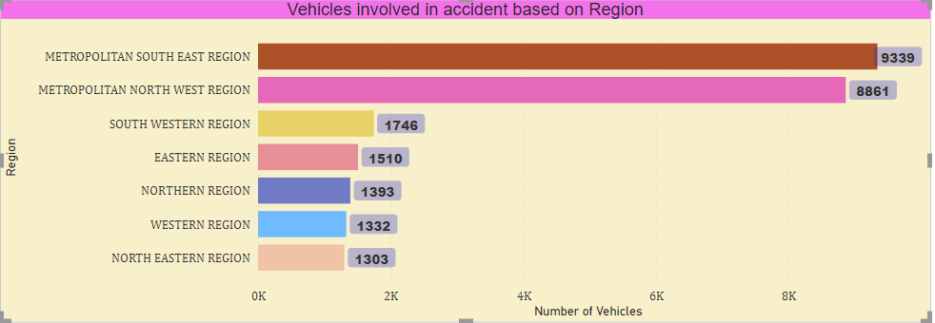
Vehicles
Vehicles in Metropolitan south East Region recorded the highest number of vehicles involved in accident, while North Eastern region recorded the least vehicles involved in an accident.
Initiatives: Introducing better public transport network in south east region can reduce the number of vehicles used in the region.

Slide 18
Summary
Road safety is a complex issue, requiring a bold, innovative and future - focused approach.
Reducing fatalities and serious injuries where speed is a contributing factor.
Improve outcomes for vulnerable and unprotected road users who are involved in a crash.
Ensuring unprotected and vulnerable road users are supported by the road system, not impacted by it.
Reducing fatalities and serious injuries where alcohol and/or drugs are involved.
Reducing fatalities and serious injuries where drivers engage in distracting behaviour.
Minimise or eliminate road safety hazards for those who work on or use the road for work.
Making remote and rural roads safe for all road users.
Preparing the road network for the increasing connectivity and automation of vehicles.
Optimising road safety data across government agencies to inform future action plans and strategies.

Slide 19
The End
Thank you All!
Questions?

